Slide 1
Data
Miss L
Year 9

Slide 2
Learning Intentions
Students will be able to
Describe the two types of data
Describe the two types of quantitative data
List the two ways to collect data

Slide 3
What’s the Difference??
Students Heights
Country
Temperature
Gender
Number of People
Colour

Slide 4
24
7
30
Data
Date:
EQ – What are the different types of data and how do we collect data?
DATA
What are the two types of data?
Quantitative
Qualitative
This type of data is represented by numbers
Example:
Height (2m, 1.4m, 0.9m)
Temperature (23°C)
Number of people
This type of data is represented by categories
Example:
Country (Africa, Australia)
Gender (female, male)

Slide 5
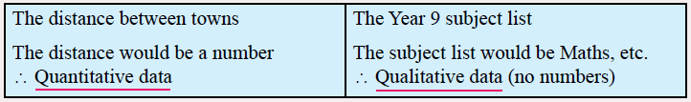
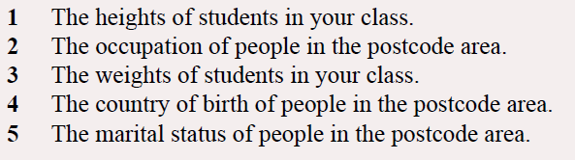
24
7
30
Data
Date:
EQ – What are the different types of data and how do we collect data?
Examples
What are the two types of data?

Slide 6
24
7
30
Data
Date:
EQ – What are the different types of data and how do we collect data?
DATA
What are the two types of Quantitative Data?
Quantitative
Discrete
Continuous
This type of data is counted
Example:
TVs in the house
Number of people
This type of data is measured
Example:
Weight
Time to run 100m

Slide 7
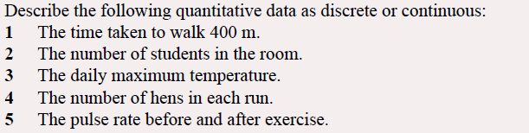
24
7
30
Data
Date:
EQ – What are the different types of data and how do we collect data?
Examples
What are the two types of Quantitative Data?

Slide 8

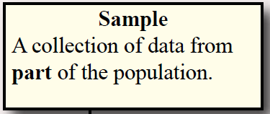

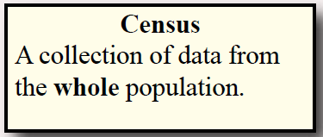
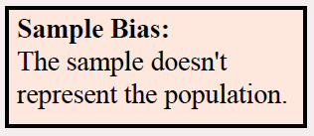
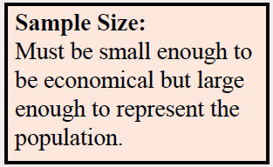
24
7
30
Data
Date:
EQ – What are the different types of data and how do we collect data?
Collecting Data
There are two ways to collect data:
How do we collect data?
A census is more accurate but samples are quicker and cheaper.

Slide 9
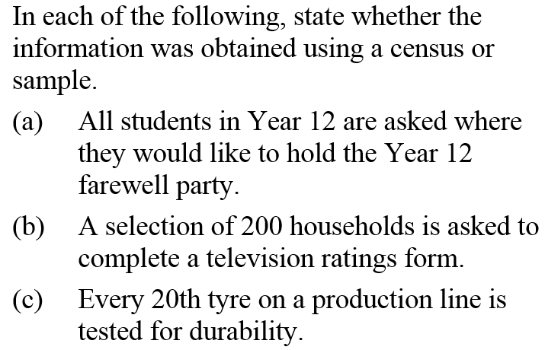
Example
a) Census b) Sample c) Sample

Slide 10
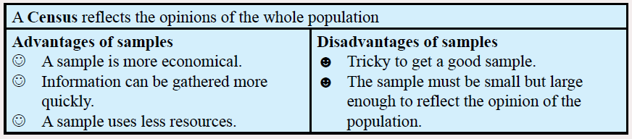
24
7
30
Data
Date:
EQ – What are the different types of data and how do we collect data?

Slide 11
Task
Complete the worksheet
Complete your summary on types of data and how to collect data
Notes:
Guide students through the question.
Option 2: Dot plots handout (Scaffolded for kids who may need extra help)

